Slide 1



Implementing Transformer with Python & PyTorch
Quang Duong

Slide 2
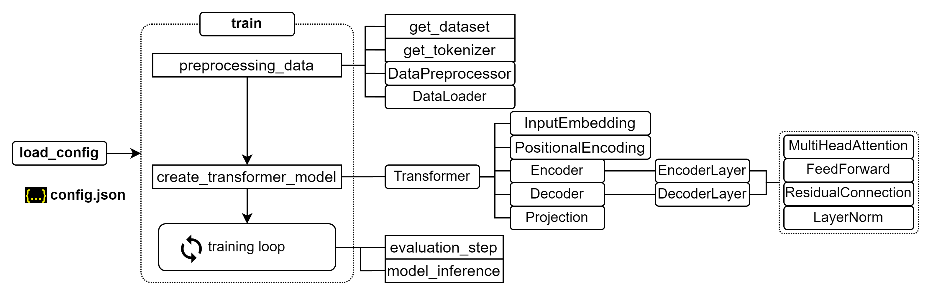
Training process for transformer

Slide 3
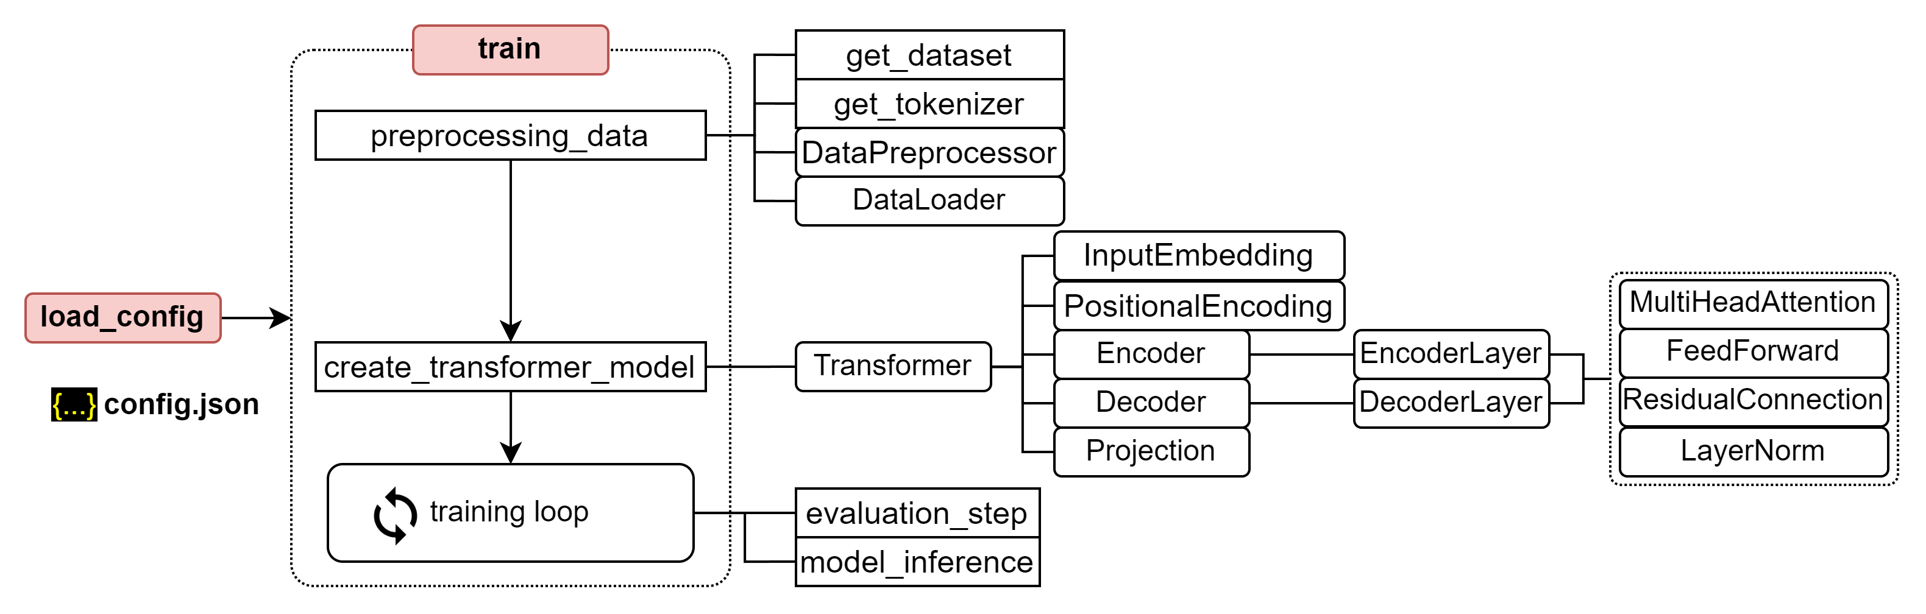
Training process for transformer

Slide 4
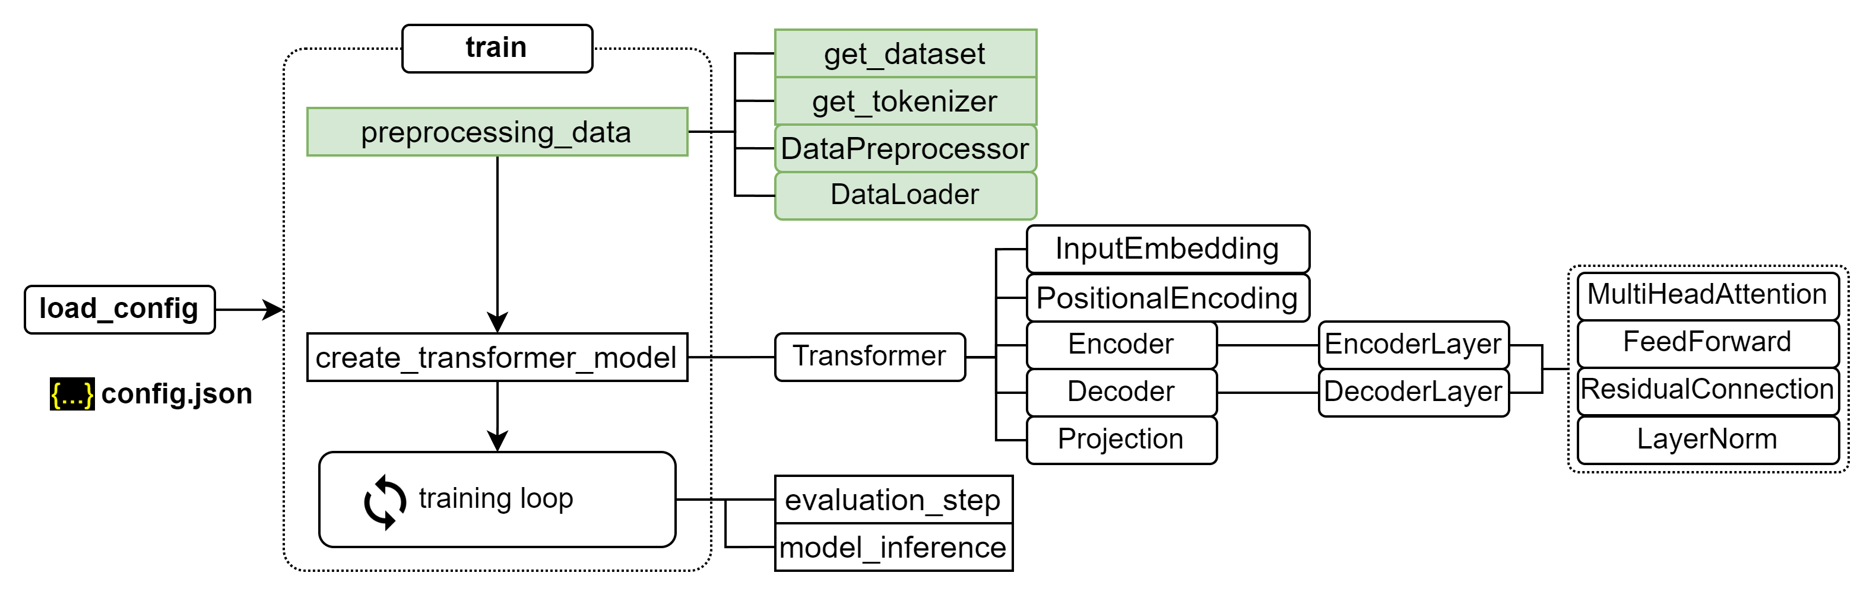
Training process for transformer

Slide 5
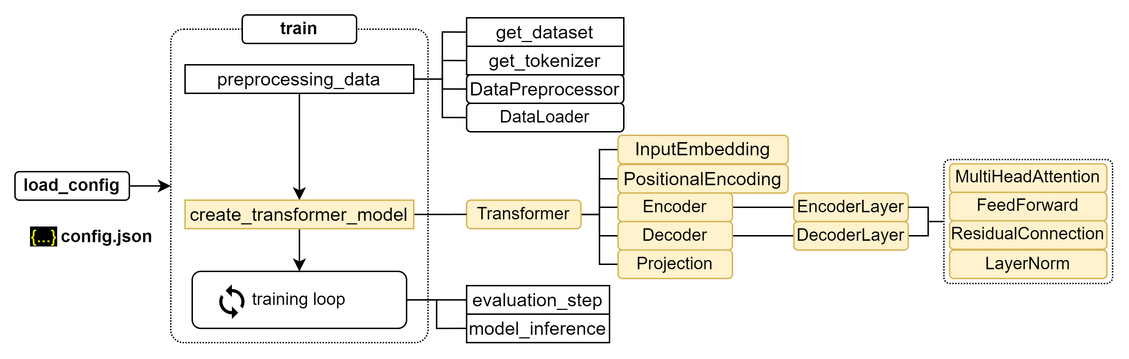
Training process for transformer

Slide 6
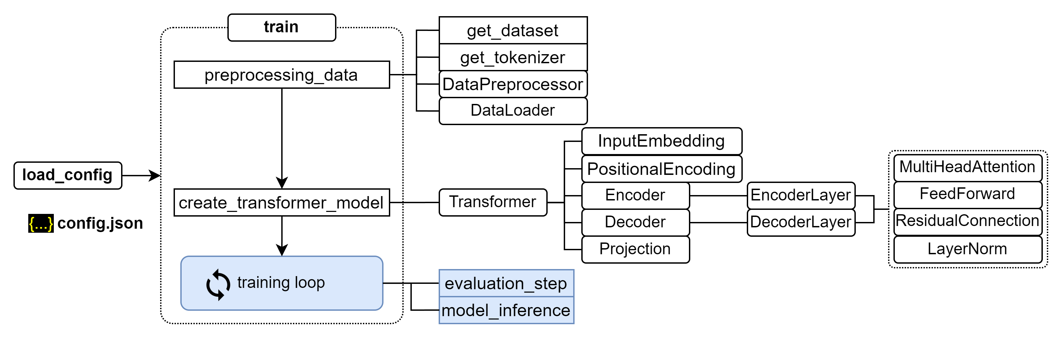
Training process for transformer

Slide 7
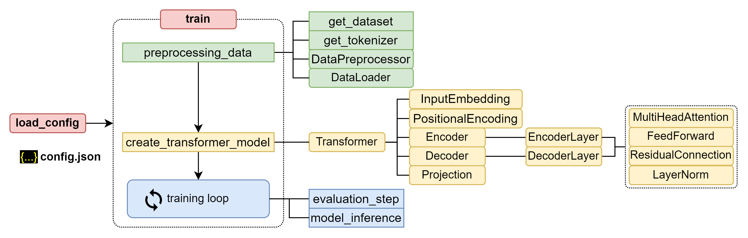
Training process for transformer

Slide 8
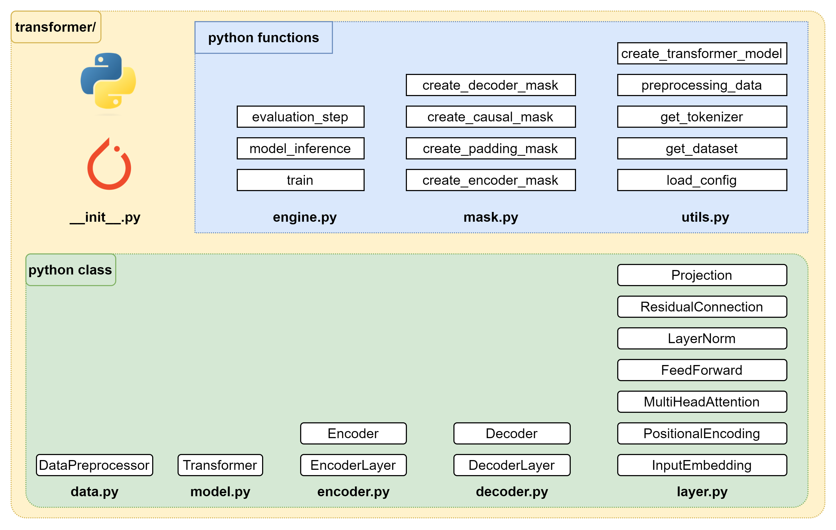
Building Transformer package

Slide 9
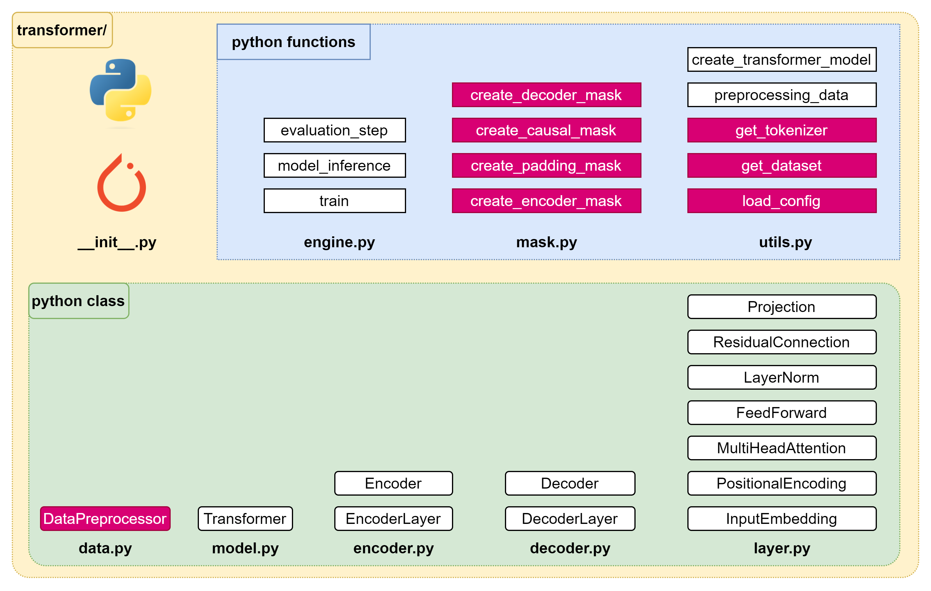
Implementation – Plan of attack (1/4)

Slide 10
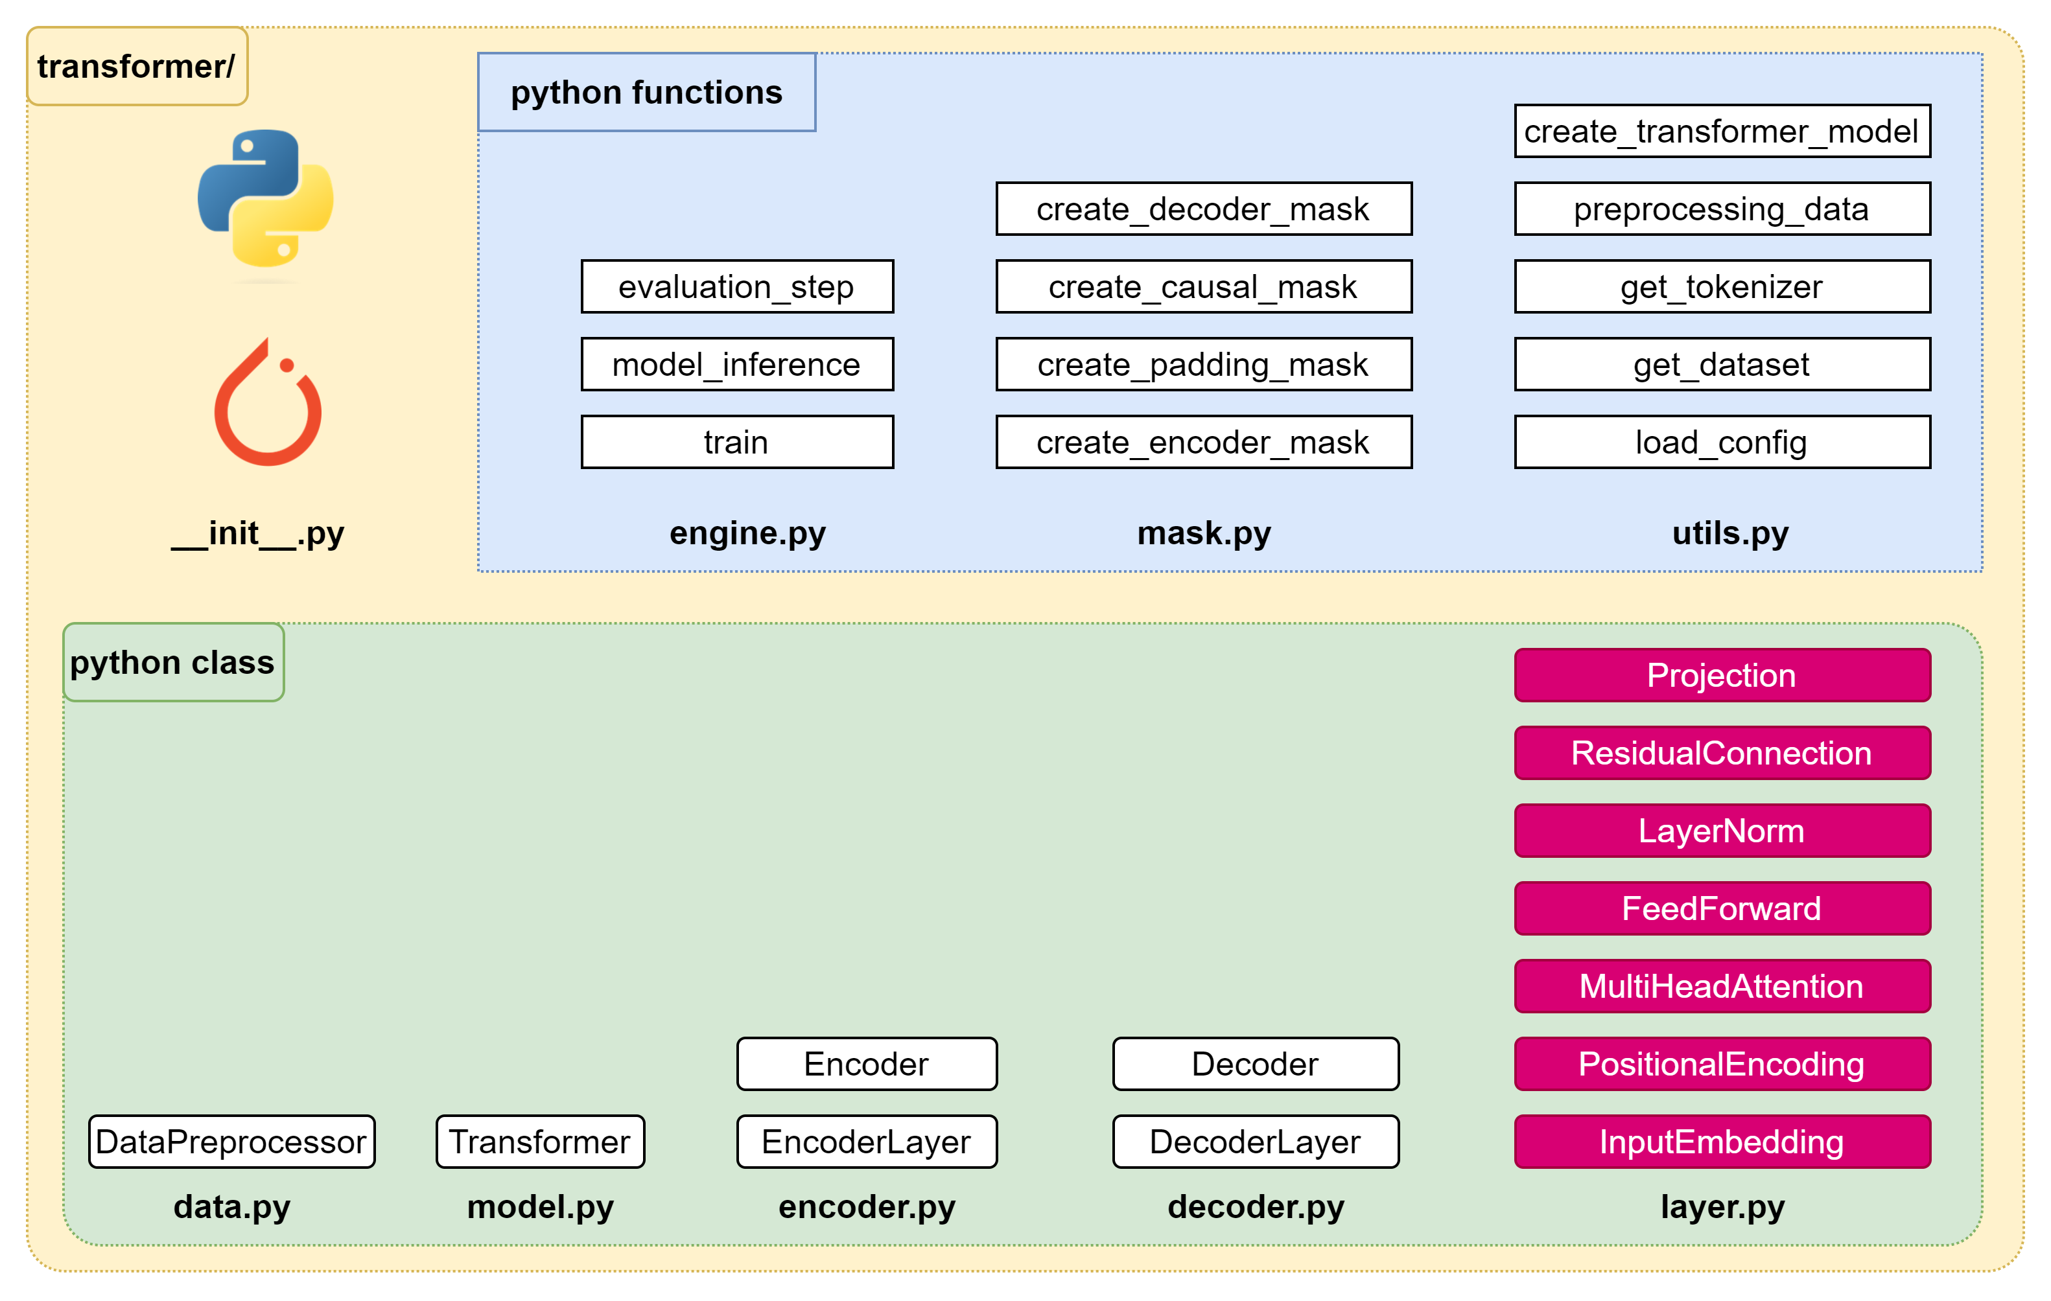
Implementation – Plan of attack (2/4)

Slide 11
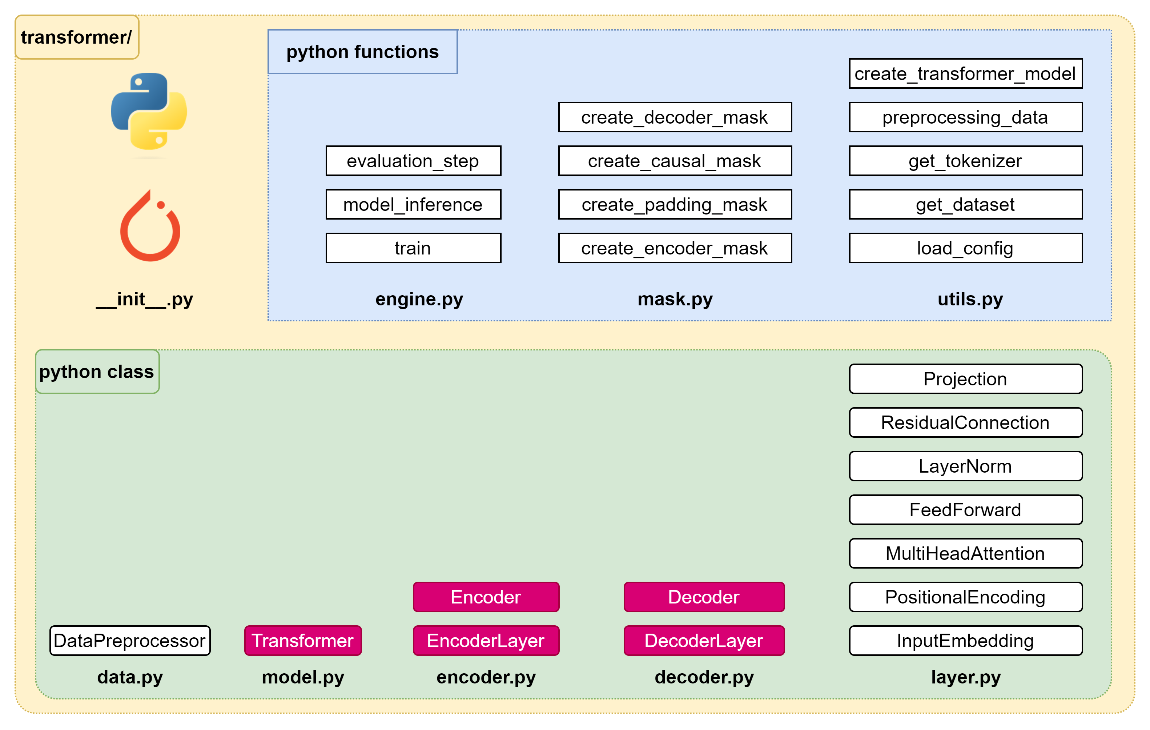
Implementation – Plan of attack (3/4)

Slide 12
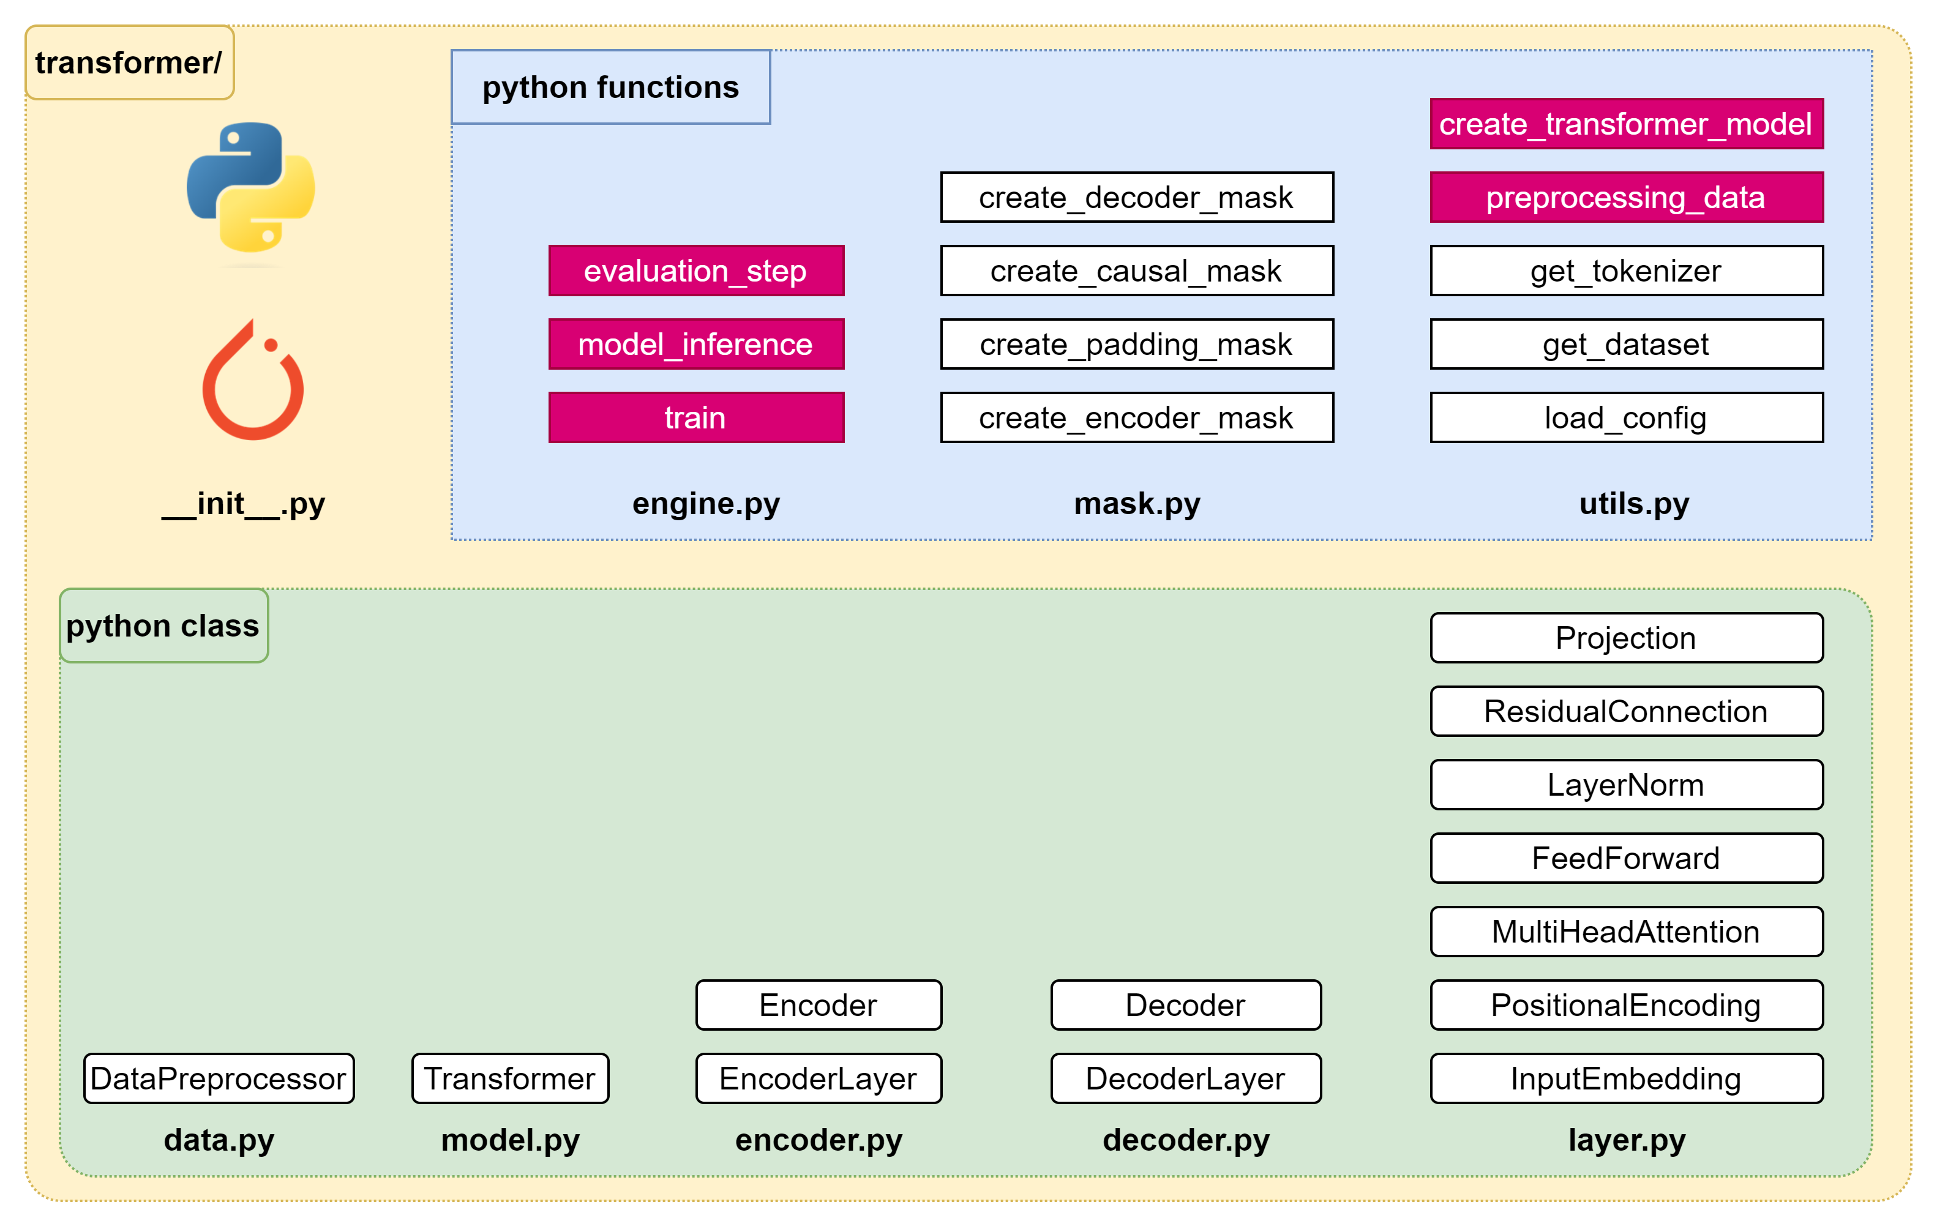
Implementation – Plan of attack (4/4)

Slide 14
Implementation – Plan of attack (1/4)

Slide 15

Data – Data Preprocessor

Slide 17
Implementation – Plan of attack (2/4)

Slide 19
Implementation – Plan of attack (3/4)

Slide 20

Encoder
encoder.py
import torch.nn as nn
from transformer.layer import FeedForward, MultiHeadAttention, ResidualConnection, LayerNorm
class EncoderLayer(nn.Module):
def __init__(self, d_model: int, self_attention: MultiHeadAttention, feed_forward: FeedForward, dropout: float,
) -> None:
super().__init__()
self.self_attention = self_attention
self.feed_forward = feed_forward
# Initialize the residual connections.
self.residual_connections = nn.ModuleList([ResidualConnection(d_model, dropout) for _ in range(2)])
def forward(self, x, mask_scr=None):
# x: [batch_size, seq_len, d_model]
# First, it applies the self-attention mechanism to the input inside a residual connection.
x = self.residual_connections[0](x, lambda x: self.self_attention(x, x, x, mask_scr))
# Then, it passes the result through the feed-forward network inside another residual connection.
x = self.residual_connections[1](x, self.feed_forward)
return x # [batch_size, seq_len, d_model].

Slide 21
Encoder
encoder.py
class Encoder(nn.Module):
def __init__(self, d_model: int, encoder_layer: EncoderLayer, num_layers: int) -> None:
super().__init__()
# Initialize the layers of the encoder.
self.layers = nn.ModuleList([encoder_layer for _ in range(num_layers)])
# Initialize the layer normalization.
self.norm = LayerNorm(d_model)
# The forward method is called when we pass input data into this module.
def forward(self, x, mask_scr=None):
# x: [batch_size, seq_len, d_model]
# It passes the input through each layer in turn.
for layer in self.layers:
x = layer(x, mask_scr)
# Finally, it applies layer normalization to the output of the last layer.
return self.norm(x) # [batch_size, seq_len, d_model].

Slide 22
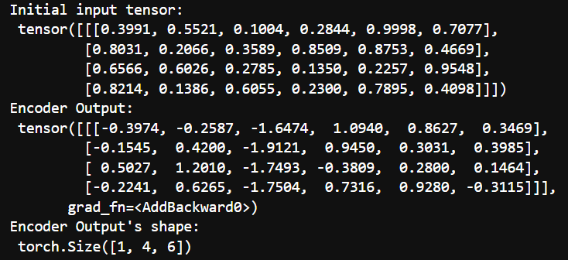
Encoder
nb_decoder.ipynb
import torch
from transformer.layer import MultiHeadAttention, FeedForward, LayerNorm
from transformer.encoder import EncoderLayer, Encoder
# Define configuration
d_model = 6 # feature dimension
h = 3 # number of heads
dropout = 0.1 # dropout ratio
d_ff = 2048 # the dimension of the feed forward network
batch = 1 # batch size
seq_len = 4 # sequence length num_layers = 3 # number of encoder layer
# Create an instance of the MultiHeadAttention & FeedForward classes
self_attention_engine = MultiHeadAttention(d_model, h, dropout)
feed_forward = FeedForward(d_model, d_ff, dropout)
# Create an instance of the EncoderLayer class
encoder_layer = EncoderLayer(d_model, self_attention_engine, feed_forward, dropout)
# Create an instance of the Encoder class
encoder = Encoder(d_model, encoder_layer, num_layers)
# Create a random tensor to represent a batch of sequences
torch.manual_seed(68) # for reproducible result of random process
x = torch.rand(batch, seq_len, d_model)
# Pass the tensor through the encoder
output = encoder(x)
print("Initial input tensor: \n", x)
print("Encoder Output: \n", output)
print("Encoder Output's shape: \n", output.shape)

Slide 24
Decoder
decoder.py
import torch.nn as nn
from transformer.layer import FeedForward, MultiHeadAttention, ResidualConnection, LayerNorm
class DecoderLayer(nn.Module):
def __init__(self, d_model: int, self_attention: MultiHeadAttention,
encoder_decoder_attention: MultiHeadAttention,
feed_forward: FeedForward, dropout: float) -> None:
super().__init__()
self.self_attention_engine = self_attention
self.encoder_decoder_attention = encoder_decoder_attention
self.feed_forward = feed_forward
# Initialize the residual connections.
self.residual_connections = nn.ModuleList([ResidualConnection(d_model, dropout) for _ in range(3)])
def forward(self, x, encoder_output, mask_src=None, mask_tgt=None):
# x: [batch_size, seq_de, d_model], encoder_output: [batch_size, seq_len, d_model]
x = self.residual_connections[0](x, lambda x: self.self_attention_engine(x, x, x, mask_tgt))
x = self.residual_connections[1](x, lambda x: self.encoder_decoder_attention(x, encoder_output, encoder_output, mask_src))
x = self.residual_connections[2](x, self.feed_forward)
return x

Slide 25
Decoder
decoder.py
class Decoder(nn.Module):
def __init__(self, d_model: int, decoder_layer: DecoderLayer, num_layers: int) -> None:
super().__init__()
# Initialize the layers of the decoder.
self.layers = nn.ModuleList([decoder_layer for _ in range(num_layers)])
# Initialize the layer normalization.
self.norm = LayerNorm(d_model)
def forward(self, x, encoder_output, mask_src=None, mask_tgt=None):
# x: [batch_size, seq_len, d_model]
# It passes the input and the encoder output through each layer in turn.
for layer in self.layers:
x = layer(x, encoder_output, mask_src, mask_tgt)
# Finally, it applies layer normalization to the output of the last layer.
return self.norm(x) # [batch_size, seq_len, d_model].

Slide 26
Decoder
nb_decoder.ipynb
import torch
from transformer.layer import MultiHeadAttention, FeedForward, LayerNorm
from transformer.decoder import DecoderLayer, Decoder
# Define configuration
d_model = 6 # feature dimension
h = 6 # number of heads
dropout = 0.1 # dropout ratio
d_ff = 2048 # the dimension of the feed forward network
batch_size = 1 # batch size
seq_len = 4 # sequence length
num_layers = 3 # number of encoder layer
# Create an instance of the MultiHeadAttention and FeedForward classes
self_attention = MultiHeadAttention(d_model, h, dropout)
encoder_decoder_attention = MultiHeadAttention(d_model, h, dropout)
feed_forward = FeedForward(d_model, d_ff, dropout)
# Create an instance of the DecoderLayer class
decoder_layer = DecoderLayer(d_model, self_attention, encoder_decoder_attention, feed_forward, dropout)
# Create an instance of the Decoder class
decoder = Decoder(d_model, decoder_layer, num_layers)
# Create a random tensor to represent a batch of sequences
torch.manual_seed(68) # for reproducible result of random process
x = torch.rand(batch_size, seq_len, d_model)
torch.manual_seed(101) # for reproducible result of random process
encoder_output = torch.rand(batch_size, seq_len, d_model)
# Pass the tensor through the decoder
output = decoder(x, encoder_output)

Slide 28
Transformer
model.py
import torch.nn as nn
from transformer.layer import InputEmbedding, PositionalEncoding, Projection
from transformer.encoder import Encoder
from transformer.decoder import Decoder
class Transformer(nn.Module):
def __init__(self, encoder: Encoder,
decoder: Decoder,
embed_src: InputEmbedding,
embed_tgt: InputEmbedding,
pos_src: PositionalEncoding,
pos_tgt: PositionalEncoding,
projection: Projection,
) -> None:
super().__init__()
self.encoder = encoder
self.decoder = decoder
self.embed_src = embed_src
self.embed_tgt = embed_tgt
self.pos_src = pos_src
self.pos_tgt = pos_tgt
self.projection = projection
def encode(self, src, mask_src=None):
src = self.embed_src(src)
src = self.pos_src(src)
return self.encoder(src, mask_src)
def decode(self, tgt, encoder_output, mask_src=None, mask_tgt=None):
tgt = self.embed_tgt(tgt)
tgt = self.pos_tgt(tgt)
return self.decoder(tgt, encoder_output, mask_src, mask_tgt)
def project(self, x):
return self.projection(x)

Slide 30
Implementation – Plan of attack (4/4)

Slide 31
Utils – Preprocessing data
utils.py
def preprocessing_data(config):
# Get the raw dataset
raw_dataset = get_dataset(config)
# Initialize tokenizers for the source & target languages
tokenizer_src = get_tokenizer(config, raw_dataset, config["language_source"])
tokenizer_tgt = get_tokenizer(config, raw_dataset, config["language_target"])
# Calculate the sizes of the training, validation, and test sets
train_ds_size = int(len(raw_dataset) * 0.7)
val_ds_size = int(len(raw_dataset) * 0.2)
test_ds_size = len(raw_dataset) - train_ds_size - val_ds_size
# Split the raw dataset into training, validation, and test sets
train_raw_dataset, val_raw_dataset, test_raw_dataset = random_split(raw_dataset, [train_ds_size, val_ds_size, test_ds_size])
# Preprocess the training, validation, and test sets
train_ds = DataPreprocessor(
train_raw_dataset,
tokenizer_src, tokenizer_tgt,
config["language_source"],
config["language_target"],
config["seq_len"],)
val_ds = DataPreprocessor(
val_raw_dataset,
tokenizer_src, tokenizer_tgt,
config["language_source"],
config["language_target"],
config["seq_len"],)
test_ds = DataPreprocessor(
test_raw_dataset,
tokenizer_src, tokenizer_tgt,
config["language_source"],
config["language_target"],
config["seq_len"],)

Slide 32
Utils – Preprocessing data
utils.py
# Create DataLoaders for the training, validation, and test sets
train_dataloader = DataLoader(train_ds, batch_size=config["batch_size"], shuffle=True)
val_dataloader = DataLoader(val_ds, batch_size=1, shuffle=True)
test_dataloader = DataLoader(test_ds, batch_size=1, shuffle=True)
return (
train_dataloader,
val_dataloader,
test_dataloader,
tokenizer_src,
tokenizer_tgt,
)

Slide 33
Utils – Create transformer model
utils.py
def create_tranformer_model(config, vocab_size_src, vocab_size_tgt) -> Transformer:
# Extract parameters from the configuration
d_model = config["d_model"]
num_layers = config["num_layers"]
h = config["h"]
d_ff = config["d_ff"]
dropout = config["dropout"]
seq_len = config["seq_len"]
# Initialize the source and target embedding layers
embed_src = InputEmbedding(vocab_size_src, d_model)
embed_tgt = InputEmbedding(vocab_size_tgt, d_model)
# Initialize the source & target positional encoding layers
pos_src = PositionalEncoding(d_model, seq_len, dropout)
pos_tgt = PositionalEncoding(d_model, seq_len, dropout)
# Initialize the encoder with self-attention and feed-forward layers
self_attention_encoder = MultiHeadAttention(d_model, h, dropout)
feed_forward_encoder = FeedForward(d_model, d_ff, dropout)
encoder_layer = EncoderLayer(
d_model, self_attention_encoder, feed_forward_encoder, dropout)
encoder = Encoder(d_model, encoder_layer, num_layers)

Slide 34
Utils – Preprocessing data
utils.py
# Initialize the decoder with self-attention, encoder-decoder attention, and feed-forward layers
self_attention_decoder = MultiHeadAttention(d_model, h, dropout)
encoder_decoder_attention = MultiHeadAttention(d_model, h, dropout)
feed_forward_decoder = FeedForward(d_model, d_ff, dropout)
decoder_layer = DecoderLayer(
d_model,
self_attention_decoder,
encoder_decoder_attention,
feed_forward_decoder,
dropout,
)
decoder = Decoder(d_model, decoder_layer, num_layers)
# Initialize the projection layer
projection = Projection(d_model, vocab_size_tgt)
# Initialize the Transformer model
transformer = Transformer(
encoder,
decoder,
embed_src,
embed_tgt,
pos_src,
pos_tgt,
projection,
)
# Initialize the model parameters with Xavier uniform distribution
for param in transformer.parameters():
if param.dim() > 1:
nn.init.xavier_uniform_(param)
return transformer

Slide 36
Engine – Train
engine.py
import os
import torch
import torch.nn as nn
from torch.utils.tensorboard import SummaryWriter
import torchmetrics.text as metrics
from transformer.mask import create_causal_mask from tqdm import tqdm
from transformer.utils import create_tranformer_model, get_checkpoint_path, create_checkpoint_path,
from transformer.utils import preprocessing_data
def train(config):
# Assign the device for computation (GPU if available, else CPU)
device = torch.device("cuda" if torch.cuda.is_available() else "cpu")
print(f"Using {device} device")
# Initiate TensorBoard writer for logging training metrics
logs = SummaryWriter(config["log_dir"])
# Check if model directory exists, if not create one to save the model weights
if not os.path.exists(config["model_dir"]):
os.mkdir("models")
# Load and preprocess the dataset
(train_dataloader, val_dataloader, _, tokenizer_src, tokenizer_tgt,) = preprocessing_data(config)

Slide 37
Engine – Train
engine.py
# Get vocab size for source and target language
vocab_size_src = tokenizer_src.get_vocab_size()
vocab_size_tgt = tokenizer_tgt.get_vocab_size()
# Create the Transformer model
model = create_tranformer_model(config, vocab_size_src, vocab_size_tgt).to(device)
# Initialize the optimizer (Adam in this case)
optimizer = torch.optim.Adam(model.parameters(), lr=config["learning_rate"], eps=1e-9)
initial_epoch = 0
global_step = 0
# Get the checkpoint path if exists
checkpoint_path = get_checkpoint_path(config)
# If a checkpoint exists, load the model and optimizer states and continue training from the last epoch
if checkpoint_path:
print(f"Loading checkpoint from {checkpoint_path}")
checkpoint = torch.load(checkpoint_path)
model.load_state_dict(checkpoint["model_state_dict"])
initial_epoch = checkpoint["epoch"] + 1
optimizer.load_state_dict(checkpoint["optimizer_state_dict"])
global_step = checkpoint["global_step"]
else:
print("No checkpoint found")

Slide 38
Engine – Train
engine.py
# Define the loss function (CrossEntropyLoss in this case)
loss_function = nn.CrossEntropyLoss(ignore_index=tokenizer_src.token_to_id("[PAD]"), label_smoothing=0.1).to(device)
# Training loop
for epoch in range(initial_epoch, config["epochs"]):
torch.cuda.empty_cache()
model.train()
batch_iterator = tqdm(train_dataloader, desc=f"Training Epoch {epoch}")
# Iterate over each batch in the training data
for batch in batch_iterator:
# Move the encoder and decoder inputs and masks to the device
encoder_input = batch["encoder_input_ids"].to(device) # (batch_size, seq_len)
decoder_input = batch["decoder_input_ids"].to(device) # (batch_size, seq_len)
encoder_mask = batch["encoder_mask"].to(device) # (batch_size, 1, 1, seq_len)
decoder_mask = batch["decoder_mask"].to(device) # (batch_size, 1, seq_len, seq_len)
# Pass the inputs through the model
encoder_output = model.encode(encoder_input, encoder_mask) # (batch_size, seq_len, d_model)
decoder_output = model.decode(decoder_input, encoder_output, encoder_mask, decoder_mask) # (batch_size, seq_len, d_model)
projection_output = model.project(decoder_output) # (batch_size, seq_len, vocab_size)
# Load target/label sequences
decoder_target = batch["decoder_target_ids"].to(device) # (batch_size, seq_len)

Slide 39
Engine – Train
engine.py
# Calculate loss
loss = loss_function(projection_output.view(-1, vocab_size_tgt), decoder_target.view(-1))
batch_iterator.set_postfix({"Training Loss": loss.item()})
# Log the loss to TensorBoard
logs.add_scalar("Training Loss", loss.item(), global_step)
logs.flush()
# Perform backpropagation
loss.backward()
# Update parameters
optimizer.step()
optimizer.zero_grad(set_to_none=True)
global_step += 1

Slide 40
Engine – Train
engine.py
# Run validation at the end of each epoch
evaluation_step(
model,
val_dataloader,
tokenizer_src,
tokenizer_tgt,
config["seq_len"],
global_step,
logs,
config["num_eval_samples"],
device,
)
# Save model checkpoint
model_checkpoint_path = create_checkpoint_path(config, f"{epoch:02d}")
torch.save(
{
"epoch": epoch,
"model_state_dict": model.state_dict(),
"optimizer_state_dict": optimizer.state_dict(),
"global_step": global_step,
},
model_checkpoint_path,
)

Slide 42
Engine – Model Inference
engine.py
def model_inference(model, encoder_input, encoder_mask, sos_id, eos_id, seq_len, device):
# Encode the input using the model
encoder_output = model.encode(encoder_input, encoder_mask) # (batch_size, seq_len, d_model)
# Initialize the decoder input with the start of sequence token
decoder_input = torch.tensor([[sos_id]]).type_as(encoder_input).to(device) # (1, 1)
# Loop until the sequence length of the decoder input equals the sequence length of the encoder input
while True:
if decoder_input.shape[1] == seq_len:
break
# Create a causal mask for the decoder input
decoder_mask = create_causal_mask(decoder_input.shape[1]).type_as(encoder_mask).to(device)
# Decode the encoder output using the model
decoder_output = model.decode(decoder_input, encoder_output, encoder_mask, decoder_mask)
# select the last token from the seq_len dimension
last_token_output = decoder_output[:, -1, :]

Slide 43
Engine – Model Inference
engine.py
# project the output to the target vocab size
projection_output = model.project(last_token_output)
# predicted_token is the indice of the max value in projection_output, meaning the id in vocabulary
_, predicted_token = torch.max(projection_output, dim=1)
decoder_input = torch.cat([decoder_input, predicted_token.unsqueeze(0).type_as(encoder_input).to(device)], dim=1)
# Break the loop if the predicted token is the end of sequence token
if predicted_token == eos_id:
break
# Return the decoder input, removing the batch dimension
return decoder_input.squeeze(0)

Slide 45
Engine – Evaluation Step
engine.py
def evaluation_step(model, val_dataloader, tokenizer_src, tokenizer_tgt, seq_len, global_step, logs, num_eval_samples, device):
# Set the model to evaluation mode
model.eval()
# Get the IDs for the start and end of sequence tokens
sos_id = tokenizer_src.token_to_id("[SOS]")
eos_id = tokenizer_src.token_to_id("[EOS]")
# Initialize lists to store the source texts, target texts, and predicted texts
source_texts = []
target_texts = []
predicted_texts = []
# Disable gradient calculations
with torch.no_grad():
# Iterate over the validation data
for batch in val_dataloader:
# Get the encoder input and mask from the batch and move them to the device
encoder_input = batch["encoder_input_ids"].to(device) # (batch_size, seq_len)
encoder_mask = batch["encoder_mask"].to(device) # (batch_size, 1, 1, seq_len)
# Assert that the batch size is 1 for evaluation
assert encoder_input.shape[0] == encoder_mask.shape[0] == 1, "Batch size must be 1 for evaluation"

Slide 46
Engine – Evaluation Step
engine.py
# Perform inference using the model
model_output = model_inference(model, encoder_input, encoder_mask, sos_id, eos_id, seq_len, device)
# Get the source text, target text, and predicted text from the batch
source_text = batch["text_src"][0]
target_text = batch["text_tgt"][0]
predicted_text = tokenizer_tgt.decode(model_output.detach().cpu().numpy())
# Append the texts to their respective lists
source_texts.append(source_text)
target_texts.append(target_text)
predicted_texts.append(predicted_text)
# Print the source text, target text, and predicted text
print(f"Source: {source_text}")
print(f"Target: {target_text}")
print(f"Predicted: {predicted_text}")
print("--------------------------------------------------")
# Break the loop if the number of evaluation samples has been reached
if len(source_texts) == num_eval_samples:
print("*************** EVALUATION COMPLETED - GO TO NEXT EPOCH ***************")
break

Slide 47
Engine – Evaluation Step
engine.py
# If logs are provided, calculate and log the BLEU score, word error rate, and character error rate
if logs:
# calculate the BLEU score
bleu_metric = metrics.BLEUScore()
bleu_score = bleu_metric(predicted_texts, target_texts)
logs.add_scalar("Validation BLEU Score", bleu_score, global_step)
logs.flush()
# calculate the word error rate
wer_metric = metrics.WordErrorRate()
wer_score = wer_metric(predicted_texts, target_texts)
logs.add_scalar("Validation Word Error Rate", wer_score, global_step)
logs.flush()
# calculate character error rate
cer_metric = metrics.CharErrorRate()
cer_score = cer_metric(predicted_texts, target_texts)
logs.add_scalar("Validation Character Error Rate", cer_score, global_step)
logs.flush()

Slide 49
